Slide 1
Kotlin 101 + ½
Notes:
This basic Kotlin introduction is recommended before this presentation: https://kotlinlang.org/docs/reference/basic-syntax.html

Slide 2
Meet Kotlin
101 + ½
Demo
Coroutines

Slide 3

About Java
We don’t want to be the first to include a feature, because every feature we add will never be removed.
Brian Goetz, Java Language Architect
Notes:
First released in 1996
Industry standard programming language
Great ecosystem, great VM, great but verbose and slowly evolving language

Slide 4
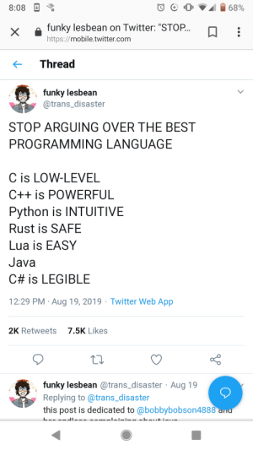
About Java
Notes:
Java is criticised long time ago because of it’s verbosity and complexity. It also has many design weakness.
https://wiki.theory.org/index.php/YourLanguageSucks#Java_sucks_because

Slide 5






About Java
Notes:
2003 Groovy (slow and problematic autocomplete)
2004 Scala (functional, slow compilation, complicated)
2007 Clojure (functional, dynamic, Lisp)
[https://openmoji.org/library/#group=smileys-emotion]

Slide 6


About Kotlin
Notes:
First appeared in 2011
“JetBrains lead Dmitry Jemerov said that most languages did not have the features they were looking for, with the exception of Scala. However, he cited the slow compilation time of Scala as a deficiency.”
https://en.wikipedia.org/wiki/Kotlin_(programming_language)
Kotlin is very popular because it’s expressive syntax and it’s fully interoperable with Java.

Slide 7
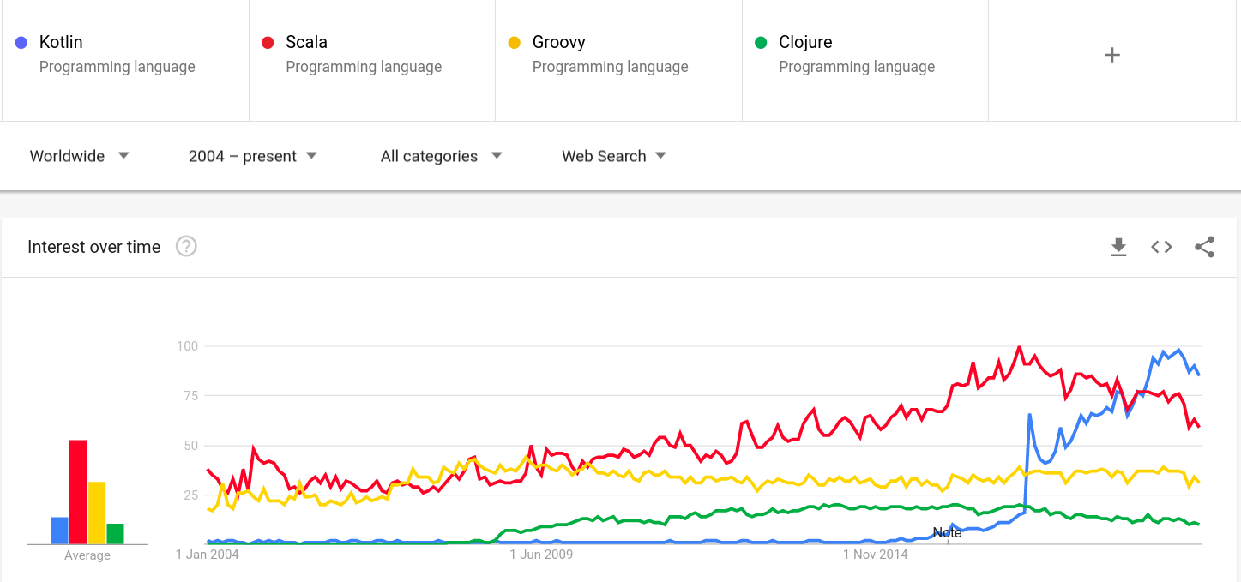
About Kotlin
Notes:
Kotlin became very popular first among Android developers (they use JDK6) and gained a lot of attention later among backend developers as well

Slide 8

About Kotlin
Notes:
Still many companies and developers are afraid to migrate because they are afraid that Kotlin is just another hype.
(it doesn’t bite)
https://devrant.com/rants/651554/rant

Slide 9

About Kotlin
Notes:
In May 2019 Google announced that Kotlin is their preferred for Android development (and shortly Spring also announced Kotlin as their preferred language), so it became clear that the language is mature and stable enough.
https://me.me/i/google-kotlin-java-java-no-you-didn%E2%80%99t-1c90464fb0e14f0b84e9adf63ad468e1

Slide 10
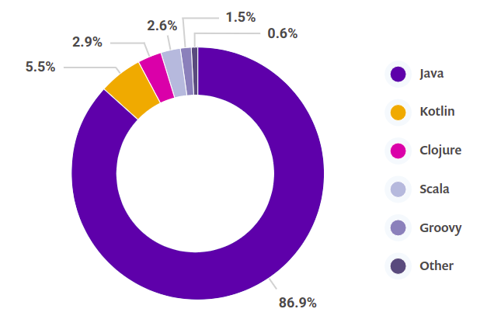
Snyk JVM Ecosystem Report 2020
Notes:
Kotlin is now the second most popular JVM language.
https://snyk.io/wp-content/uploads/jvm_2020.pdf

Slide 11
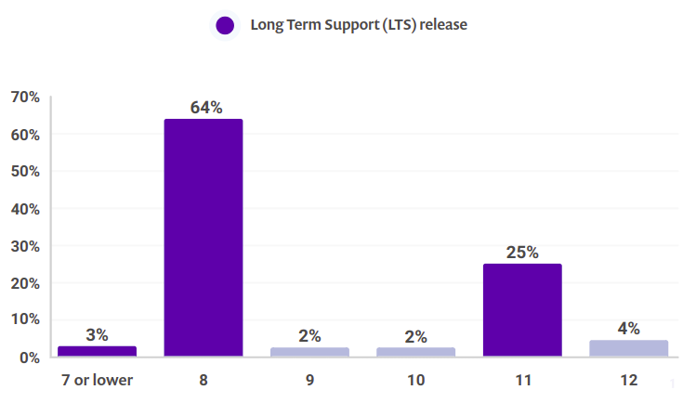
Snyk JVM Ecosystem Report 2020
Notes:
(how many of you are using JDK8 or below? How many of you are familiar with JDK 11 features? And above? Lombok?)
Most projects stuck on JDK8
https://snyk.io/wp-content/uploads/jvm_2020.pdf

Slide 12
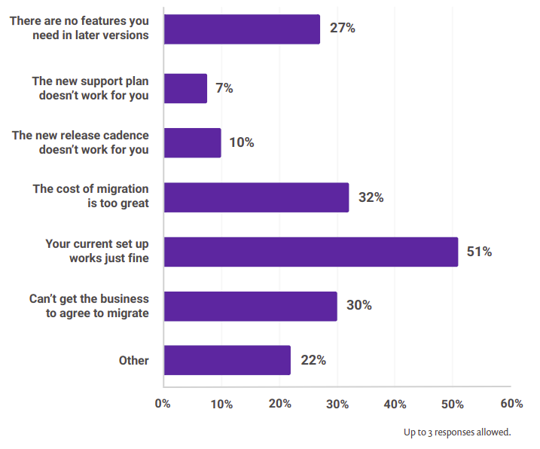
Snyk JVM Ecosystem Report 2020
Notes:
One of the main reasons are: cost of migration and business does not agree to migrate
https://snyk.io/wp-content/uploads/jvm_2020.pdf

Slide 13
Where Kotlin shines
Allows step by step migration
Increased productivity
More readable code
Safer code design and fewer error
Easy to learn
Great IDE support
Great community and ecosystem (MockK, Arrow, Ktor, Kodein, TornadoFX, etc + Java ecosystem)
Supported by Gradle
Open-source with Apache 2 license
Multiplatform* (JS, iOS, WebAssembly, Arm)
Notes:
IDE: converts Java snippets to Kotlin, and some plugins generate JSON data to Kotlin data class
Null safety and immutability
Gradle has better auto completion with Kotlin
Ecosystem: https://github.com/KotlinBy/awesome-kotlin
*Multiplatform: in progress
https://phauer.com/2018/convincing-management-introduce-kotlin/

Slide 14

101
Notes:
Presentation about comparing Kotlin and JDK features. JDK19 in end of 2022 will have the state of Kotlin at the moment.
https://www.youtube.com/watch?v=te3OU9fxC8U

Slide 15
101
;
Notes:
The most important feature - ; is not mandatory

Slide 16
101
;)
The fun keyword is used to declare a function. Programming in Kotlin is lots of fun, indeed!
Kotlin in Action, chapter 2.1.1
Notes:
Just kidding, I would like to skip the very basic stuff like ;, fun, var, val, no primitives, everything is final and public, free file structure, override is a keyword, etc.
You can check this in any basic Kotlin introduction presentation
Let’s concentrate on the fun parts
Article about final and public: https://discuss.kotlinlang.org/t/a-bit-about-picking-defaults/1418

Slide 17
101 + ½
Kotlin 101 + ½
Notes:
Kotlin 102 https://www.youtube.com/watch?v=1KldcFc7HCY

Slide 18
Destructuring declarations
creates multiple variables from a single data object
arrays, pairs and triples val (first, _, third) = arrayOf(1, 2, 3, 4, 5) val (first, _, third) = Triple("first", 2, true)
maps for ((k, v) in map) { ... }
data classes data class Person(val name: String, val age: Int, val isMale: Boolean) val (name, _, isMale) = Person("John", 18, true)
Notes:
destructure an object into a number of variables
You can destructure function return values and lambda parameters as well
underscore will discard value on the given position
types can differ in the same destructuring (see Triple)
data classes will be discussed later
only fields with matching name will be destructured
https://kotlinlang.org/docs/reference/multi-declarations.html

Slide 19
Type aliases
provides alternative name for existing types typealias FileTable<K> = MutableMap<K, MutableList<File>> typealias MyHandler = (Int, String, Any) -> Unit
compiler always expands the alias (not a new type) typealias NamesByDepartments = Map<String, List<String>> fun get ByDepartment(names: NamesByDepartments): List<String> { return names.getOrDefault("IT", listOf()) }
Notes:
You can use them in function types and lambdas
function descriptors can be aliased too
Useful when you have to use classes with same name from different package (i.e. message consumers and converters), so you don’t have to write explicit packages everywhere
https://kotlinlang.org/docs/reference/type-aliases.html

Slide 20
Ranges and Progressions
provides arithmetic progressions for Int, Long and Char types for (i in 1..4) print(i) //1234 for (i in 1 until 10) print(i) //123456789 for (i in 'Z' downTo 'A' step 2) print(i) //ZXVTRPNLJHFDB
it is possible to implement custom ranges by overloading ”..” operator (rangeTo).
ranges are defined for comparable type and you can check if any instance is within the range val versionRange = Version(1, 11)..Version(1, 30) Version(0, 9) in versionRange //false Version(1, 20) in versionRange //true
Notes:
By default ranges are inclusive
https://kotlinlang.org/docs/reference/ranges.html
https://kotlinlang.org/docs/reference/operator-overloading.html

Slide 21
Collections and streams
stream operations are instantly available on any collection val result = listOf("one", "two", "three", "four") .mapIndexed { idx, value -> "${idx+1}${value.substring(1)}" } //[1ne,2wo,3hree,4our] .filter { it.length > 3 } //[3hree,4our] .reversed() //[4our,3hree]
a lot of stream operations, i.e: drop*, take*, reduce*, fold*, zip*, windowed, associate*, etc.
sequenceOf(..) provides the same operations but with lazy evaluation (huge or streaming collections)
sequence generators can be used where generator stops when null is returned val oddNumbersLessThan10 = generateSequence(1) { if (it < 10) it + 2 else null } oddNumbersLessThan10.count() //6
or consumer requests no more items val oddNumbers = sequence { yield(1) yieldAll(listOf(3, 5)) yieldAll(generateSequence(7) { it + 2 }) } oddNumbers.take(5).toList() //[1, 3, 5, 7, 9]
Notes:
no .stream() and no terminal operation required, every step will produce a new list; it can be used on single parameters
sequences are evaluate step-by-step and one-by-one, meanwhile stream operations are evaluated eagerly and every operation results an intermittent collection
yieldAll returns a list of items when requested; generateSequence returns items from the seed item (7)
https://kotlinlang.org/docs/reference/collections-overview.html

Slide 22
Collections and streams
list specific operations, i.e.: binarySearch class Product(val name:String, val price:Double) val productList = listOf( Product("AppCode", 99.0), Product("WebStorm", 99.0), Product("DotTrace", 129.0)) productList.binarySearch(Product("WebStorm", 99.0), compareBy<Product> { it.price }.thenBy { it.name }) //1
set specific operations, i.e.: val numbers = setOf(1, 2, 3) numbers union setOf(4, 5) //[1,2,3,4,5] numbers intersect setOf(2, 1) //[1,2] numbers subtract setOf(3, 4) //[1,2]
map specific operations, i.e.: val numbersMap = mapOf("one" to 1) numbersMap + mapOf("two" to 2, "one" to 11) //{one=11, two=2} numbersMap - "one" //{}
Notes:
binary search: collection must be sorted, if it’s element are not Comparable a comparator can be provided, and the items must be sorted by the comparator’s defined order; binary search is significantly faster then other built-in search functions
built-in union, intersect and subtract operations on sets
addition and subtraction of items on maps are easy
https://kotlinlang.org/docs/reference/collections-overview.html

Slide 23
Functions
spread operator val a = arrayOf(1, 2, 3) val list = asList(-1, 0, *a, 4) //[-1,0,1,2,3,4]
default arguments and named arguments fun formatName(firstName: String, middleName: String = "", lastName: String): String { ... } formatName(lastName = "Doe", firstName = "John")
single-expression function fun double(x: Int) = x * 2
local functions fun prefixDr(name: String):String { val prefix = "Dr." fun addPrefix(name: String) = "$prefix $name" return addPrefix(name) }
Notes:
values for vararg parameter can be unpacked by spread operator.
default argument can be omitted, and the order of named arguments are arbitrary. This makes the code more readable and robust to refactorings. No need for method overloading
when a function returns a single expression, the curly braces can be omitted and the body is specified after a = symbol (return type is also inferred)
local functions can access outer functions variable. (String interpolation) The scope is more restricted than for private methods
https://kotlinlang.org/docs/reference/functions.html

Slide 24
Extensions
extends any receiver type without inheriting fun <T> List<T>.lastReversed(size: Int) = takeLast(size).reversed() listOf(1,2,3,4).lastReversed(2) //[4, 3]
extensions are resolved statically, without inserting new members into the receiver class (no overhead)
member function with same signature always wins
extension property (no backing field) private val <T> List<T>.lastIndex: Int get() = size - 1 listOf(1,2).lastIndex //1
Notes:
this could be omitted in many cases
extensions can have visibility modifiers (will not accidentally leak into other types/packages) (good for rich data models and data mappers)
they could be opened and overridden as well
https://kotlinlang.org/docs/reference/extensions.html

Slide 25
Classes
primary constructor cannot contain any initialization logic (use init block) open class Order(val itemName:String, val quantity:Int = 1, val price:Double) { val time = Instant.now() val total: Double init { total = quantity * price } } Order("Galaxy S10", price = 739.99) //goodbye builders
all classes inherit from Any which implements equals(), hashCode() and toString()
concise inheritance class DozenOrder(name: String, price: Double): Order(name, 12, price * 0.85)
data classes also adds destructuring and copy method to clone object data class Student(val name:String, val age:Int, val isMale:Boolean = true) val student = Student("John", 17) val (name, age) = student.copy(age = 18) //John, 18
Notes:
Init block can be used to initialize final variables
Classes are final by default (use open)
Property setters and getters are generated for Java compatibility
It is easy to use default values and named arguments (no more builders)
Class body could be omitted
inheritance also includes super call
copy() method creates a new variable from the original one
https://kotlinlang.org/docs/reference/classes.html
https://kotlinlang.org/docs/reference/data-classes.html

Slide 26
Sealed classes
they are an extension of enum classes (can have multiple instance and inheritable) sealed class Result(val result:Int) data class Success(val data:Int): Result(data) data class Error(val data:Int, val rootCause: Exception): Result(data)
fun notZeroResult(result: Result) = when(result) { is Success -> result.data is Error-> { val (data, rootCause) = result if (data != 0) data else { println(rootCause); null } } }
val notZeros = listOf( Success(1), Error(0, IllegalArgumentException("conversion error")) ) .mapNotNull(::notZeroResult) //[1]
Notes:
works with classes, data classes and objects
this concept allows you to easily process state based logic or handle failures without throwing exception (i.e. in functional paradigm)
https://kotlinlang.org/docs/reference/sealed-classes.html
https://blog.kotlin-academy.com/enum-vs-sealed-class-which-one-to-choose-dc92ce7a4df5

Slide 27
Null safety
compile time null safety provided by keywords, immutable types and helper methods val, Any, Collection, listOf() var, Any?, MutableCollection, mutableListOf()
safe calls: bob?.department?.head?.name bob?.let { println(it.department) }
Elvis operator: val size = name?.length ?: -1
it is still possible to have NullPointerException, i.e.:
throw NullPointerException()
using non-null safe external Java code
using !! operator: name!!.length
Notes:
Nullable things must be specified explicitly; collections are immutable
let, also and apply will operate on non-null values
by using !! operator the developer takes responsibility that a value is not null, or it will throw NPE
https://kotlinlang.org/docs/reference/null-safety.html

Slide 28
Smart casts
is checks and casts to desired type if (any is String) print(any.length) if (any is String && any.length > 0) print(any.length) if (any !is String || any.length == 0) return
as unsafe cast operator will throw ClassCastException if casting is not possible val name: String = any as String
safe nullable cast will return null if cast is not possible val name: String? = any as? String
null also can be casted val name: String? = null as String?
Notes:
is also casts within the condition as well after the first usage
https://kotlinlang.org/docs/reference/typecasts.html

Slide 29
Control flow expressions
if is an expression returning values on the last expression of each block val min = if (a < b) { println("a is smaller"); a } else { println("b is smaller"); b }
try-catch is also an expression (finally will not have effect on the result) val result: Double? = try { a/b } catch (ex: ArithmeticException) { null } finally { print("i'm done") }
when is also an expression val isMale = when (sex.toLowerCase()) { "male" -> true "female" -> false else -> null }
Notes:
when is used in Kotlin instead of switch statement
https://kotlinlang.org/docs/reference/control-flow.html

Slide 30
Lightweight pattern matching using when
when(any) { is Any -> TODO("any type") 1 -> TODO("any value") 2, 3 -> TODO("multiple value") in 'A'..'Z' -> TODO("within range") is EnumType -> TODO("is enum type") in EnumType.VALUE1..EnumType.VALUE3 -> TODO("within enum range") any == "someValue" || any == "otherValue" -> TODO("conditions") is SealedClass -> TODO("sealed classes (i.e. pattern matcher objects") in Regex("[0-9]") -> TODO("any type with overloaded operator 'contains'") } //Note: TODO is a built-in function returning Nothing
Notes:
also very useful at implementing template pattern with small differences in some of the steps
https://kotlinlang.org/docs/reference/control-flow.html#when-expression
https://programmingideaswithjake.wordpress.com/2016/08/27/improved-pattern-matching-in-kotlin/
https://proandroiddev.com/kotlin-fun-with-in-8a425704b635
https://www.baeldung.com/kotlin-when

Slide 31
Nothing
Void is a Java wrapper for void. It can be referenced from Kotlin but shouldn’t. fun foo(): Void? = null
Unit is the Kotlin’s equivalent of “no return anything” (void) fun foo(): Unit = print("foo") val foo = foo() //foo print(foo) //kotlin.Unit
Nothing means function doesn’t return any value, not even Unit fun throwException(): Nothing = throw IllegalArgumentException()
fun foo(): String { throwException() return person.name // Compiler warns that this is unreachable code }
fun bar(): String = person.name ?: throwException()
Notes:
Void is a type for Kotlin, but it’s not instantiable, so you need to return null
Nothing will save us from potential bugs (foo will have compile time warning, but bar will compile, exception is a fallback mechanism if person is null)
https://www.baeldung.com/kotlin-void-type
https://stackoverflow.com/questions/44834965/what-does-void-return-type-mean-in-kotlin
https://medium.com/@marcinmoskala/unit-is-not-special-except-of-being-default-return-type-it-is-just-singleton-6078130dbe34
https://medium.com/@agrawalsuneet/the-nothing-type-kotlin-2e7df43b0111
https://blog.kotlin-academy.com/the-beauty-of-kotlin-typing-system-7a2804fe6cf0

Slide 32
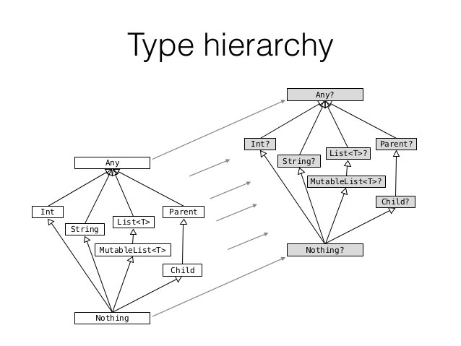
Nothing
Notes:
https://medium.com/@marcinmoskala/unit-is-not-special-except-of-being-default-return-type-it-is-just-singleton-6078130dbe34

Slide 33
Delegation
“composition over inheritance” … but it hurts in Java
Kotlin allows easy delegation using by interface Shape { fun getShape(): String } interface Color { fun getColor(): String } class Triangle: Shape { override fun getShape() = "triangle" } class Red: Color { override fun getColor() = "red" }
class ColoredShape(color: Color, shape: Shape): Color by color, Shape by shape { fun show() { print("${this.getColor()} ${this.getShape()}") } }
ColoredShape(Red(), Triangle()).show()
Notes:
composition is more flexible and allows inheriting multiple types
it hurts to implement in Java because every interface method needs to be implemented and delegated
Interface method implementation is delegated
methods can be overridden
It is very useful when you need to implement custom repository methods in Spring data, without re-implementing the Spring provided repository methods
https://kotlinlang.org/docs/reference/delegation.html
https://en.wikipedia.org/wiki/Composition_over_inheritance

Slide 34
Delegation
easy to use when need to use both Spring repository styles
interface SpringImplementedRepository : ReactiveMongoRepository<Any, String> @Repository class CustomMethodRepository( val repository: SpringImplementedRepository, val mongoTemplate: ReactiveMongoTemplate ): SpringImplementedRepository by repository { fun findByCustomLogic(value: Any): Flux<Any> = mongoTemplate… }

Slide 35
Delegated properties
operations on properties can be delegated as well
lazy computation and memoization val lazyValue by lazy { println("computed!"); "Hello" }
listening for a change of a property var name by observable("<no name>") { prop, old, new -> println("$old -> $new") }
storing properties in a map instead of separate fields class User(val map: Map<String, Any?>) { val name: String by map val age: Int by map } val user = User(mapOf("name" to "John Doe", "age" to 25))
create custom delegates by implementing operators below operator fun getValue(thisRef: Any?, property: KProperty<*>): String {...} operator fun setValue(thisRef: Any?, property: KProperty<*>, value: String) {...}
Notes:
getValue: for read-only properties
getValue + setValue: for rear-write properties
https://kotlinlang.org/docs/reference/delegated-properties.html

Slide 36
Higher-Order Functions and Lambdas
functions are first-class, so they can be stored in variables, passed as arguments and returned
the format is: (InputType1, InputType2) -> OutputType
parameter types are optional: () -> OutputType
can have a receiver type: ReceiverType.(InputType1) -> OutputType
names can be used for documenting meaning: (x: Int, y:Int) -> Point
function types can be combined: (Int) -> ((Int) -> Unit)
arrow notation is right associative: ((Int) ->(Int)) -> Unit or (Int) -> (Int) -> Unit
val sum: (Int, Int) -> Int = { x: Int, y: Int -> x + y } val sum: (Int, Int) -> Int = { x, y -> x + y } val sum = {x,y -> x + y} //when types can be inferred
val repeatFun: String.(Int) -> String = { times -> this.repeat(times) } //"hello".repeatFun(3) or repeatFun("hello", 3) val twoParameters: (String, Int) -> String = repeatFun // OK fun runTransformation(f: (String, Int) -> String) = f("hello", 3) val result = runTransformation(repeatFun) // OK
Notes:
If function has a receiver type the receiver object can be passed as the first argument
https://kotlinlang.org/docs/reference/lambdas.html

Slide 37
Domain-Specific Language
the last function parameter can be placed outside the parentheses when it’s a function fun doWithHello(f: (String, Int) -> String) = f("hello", 3) val result = doWithHello { input, times -> input.repeat(times) }
member and extension functions can omit the dot and parentheses when marked with infix infix fun Int.plus(second: Int) = this + second 1.plus(2) or 1 plus 2
helps to create readable tests by hiding boilerplate or complex logic (i.e. capturing) captureSenderMessage { assertTrue(it.eventData.isNull) } private fun captureSenderMessage(action: (OutboundMessage?) -> Unit) { argumentCaptor<Mono<OutboundMessage>>().apply { verify(senderMock, times(1)).send(capture()) action(firstValue.block()) } }
easy to build type-safe builders for markups, UI components, web server routes or test mocks
Notes:
DSLs are useful in tests or human readable declarations
https://kotlinlang.org/docs/reference/functions.html
https://kotlinlang.org/docs/reference/type-safe-builders.html

Slide 38

Demo
Notes:
Java version:
verbose and not null-safe data classes (even in constructor you can pass null)
long is a reserved keyword so the backing field needs to be renamed to _long
some stream operators are cumbersome, i.e.: groupingBy
method referencing can be misleading (ServiceFactory::toEntity vs OtpBankDto::toEntity); proper domain separation needs some static methods (not rich domain model)
easier to make hard to find mistakes with converters in dto class (i.e. dto.id, dto.openingHours)
Kotlin version:
more flexible file structure
more expressive and concise code
easier to read and faster to understand
it has the same or better performance
empowers rich domain model (extension methods operate on instance, not on static methods with passed reference)
rich set of operators on collections (i.e., filterNotNull, slice; for Java Arrays.copyOnRange on array is weird and less known)
both versions are fully interoperable

Slide 39
Coroutines
coroutines are light-weight threads which can suspend (and return) execution by calling other coroutine
runBlocking { launch { delay(1000L) println("World!") } println("Hello,") }
fun main() = runBlocking { launch { doWorld() } println("Hello,") }
suspend fun doWorld() { delay(1000L) println("World!") }
launched jobs can be cancelled or can have timeout val result = withTimeoutOrNull(1300L) { repeat(1000) { i -> println("I'm sleeping $i ..."); delay(500L) } "Done" // will get cancelled before it produces this result }
it is possible to cancel in the middle of computation if the coroutine checks for cancellation (yield or isActive)
Notes:
coroutines are light-weight threads, you can run 100.000s of them without any issue, while Java threads will run out of memory even with 100.000 threads.
runBlocking block the current coroutine scope until all coroutines are finished (GlobalScope blocks the main thread)
launch will start a new coroutine
launch will call suspending function and will return when it’s finished
cancel and timeout will throw exception, so in the finally block of try you can close your resources
withTimeoutOrNull will return null instead of throwing exception
https://kotlinlang.org/docs/reference/coroutines/coroutines-guide.html
https://kotlinlang.org/docs/reference/coroutines/cancellation-and-timeouts.html

Slide 40
Coroutines
suspendable functions are sequential when not called as coroutine suspend fun doSomethingUsefulOne(): Int { delay(1000L); return 13 } suspend fun doSomethingUsefulTwo(): Int { delay(1000L); return 29 }
val time = measureTimeMillis { val one = doSomethingUsefulOne() val two = doSomethingUsefulTwo() println("${one + two}") } // 2 sec
val time = measureTimeMillis { val one = async { doSomethingUsefulOne() } val two = async { doSomethingUsefulTwo() } println("${one.await() + two.await()}") } // 1 sec
async returns a Deferred (a promise) and .await() get it’s eventual result
cancellation is always propagated through coroutines hierarchy
Notes:
Deferred is also a Job, so it is cancellable and has timeout
async can be started lazily
cancellation is propagated, so if method doSomethingUsefulTwo() throws exception, method doSomethingUsefulOne() will cancel
https://kotlinlang.org/docs/reference/coroutines/composing-suspending-functions.html

Slide 41
Channels
Deferred transfers single value, Channels transfer a stream of values
Channel is similar to a BlockingQueue, but it works with a suspending send and receive methods val channel = Channel<Int>() launch { for (x in 1..5) channel.send(x * x) channel.close() } for (y in channel) println(y) println("Done!")
this can be replaced with produce builder and consumeEach extension function fun CoroutineScope.produceSquares(): ReceiveChannel<Int> = produce { for (x in 1..5) send(x * x) } fun main() = runBlocking { val squares = produceSquares() squares.consumeEach { println(it) } println("Done!") }
Notes:
Sending a close token is optional
https://kotlinlang.org/docs/reference/coroutines/channels.html

Slide 42
Channels
pipelines can be constructed using channels (also fan-out and fan-in) suspend fun sendString(channel: SendChannel<String>, s: String, time: Long) { while (true) { delay(time); channel.send(s) } } val channel = Channel<String>() launch { sendString(channel, "foo", 200L) } launch { sendString(channel, "BAR!", 500L) } repeat(6) { println(channel.receive()) } coroutineContext.cancelChildren() // to cancel new coroutines
buffered and ticker channels are also available
select expression is experimental
Notes:
With fan-out multiple receiver consumes the same producer, with fan-in same receiver consumes multiple producer
Ticker channel sends a Unit every given scheduled time (to trigger consumers)
Select expression is experimental: it lets consume multiple channels simultaneously (Golang like)
https://kotlinlang.org/docs/reference/coroutines/channels.html

Slide 43
Flow
it is possible to return multiple asynchronous values using Flows fun foo(): Flow<Int> = flow { //flow block can suspend for (i in 1..3) { delay(100); emit(i) } } fun main() = runBlocking<Unit> { foo().collect { value -> println(value) } }
flows are cold streams, started only when a terminal operation called (every time, i.e. collect) runBlocking<Unit> { (1..3).asFlow().take(2).collect { value -> println(value) } //1 2 }
transformation operators (ie. map, filter, zip) can be used with suspending functions
timeout and cancellation also works
some operators are still experimental
Reactive Streams TCK compliant with Reactor and RxJava2 integration
Notes:
Flows are cold streams, similar to sequences, it does not run until it is collected
.asFlow() converts a range to flow and it can be consumed within the same stream
Reactive Streams Technology Compatibility Kit = is a guide to help Reactive Streams library implementers to validate their implementations against the rules defined in the Specification
https://kotlinlang.org/docs/reference/coroutines/flow.html
https://www.reactive-streams.org/
https://medium.com/@elizarov/reactive-streams-and-kotlin-flows-bfd12772cda4
https://spring.io/blog/2019/04/12/going-reactive-with-spring-coroutines-and-kotlin-flow
https://docs.spring.io/spring/docs/5.2.0.BUILD-SNAPSHOT/spring-framework-reference/languages.html#coroutines

Slide 44

Demo
Notes:
Webflux version:
it allocates threads as it is expected by default, steps are executed independently
Flow version:
Flow pushes items one-by-one, when each item finished processing the “pipeline”
no need for flatMap for asynchronous invocation, map takes suspending functions
it also uses system threads (probably lightweight threads are not available for IO, maybe just for computation)
both have almost the same performance and resource usage

Slide 45


Resources
Demo: https://github.com/domahidizoltan/presentation-kotlin-101-0.5
Kotlin language guide: https://kotlinlang.org/docs/reference/
Dmitry Jemerov and Svetlana Isakova: Kotlin in Action
Jake Wharton: What's New in Java 19: The end of Kotlin?
any Hadi Hariri presentation:
Introduction to Kotlin
Kotlin 102 - Beyond the basics
Functional Programming with Kotlin
Blog: Convincing Your Management to Introduce Kotlin
Notes:
Articles about Kotlin performance and feature costs:
Kotlin vs Java: Compilation speed https://medium.com/keepsafe-engineering/kotlin-vs-java-compilation-speed-e6c174b39b5d
Kotlin's hidden costs - Benchmarks https://sites.google.com/a/athaydes.com/renato-athaydes/posts/kotlinshiddencosts-benchmarks
Java vs. Kotlin — Part 1: Performance https://medium.com/rsq-technologies/comparative-evaluation-of-selected-constructs-in-java-and-kotlin-part-1-dynamic-metrics-2592820ce80
Java vs. Kotlin — Part 2: Bytecode https://medium.com/rsq-technologies/java-vs-kotlin-part-2-bytecode-42b2154f6ae0

Slide 46
Thank you
? :
Zoltán Domahidi Senior Kotlin/Java developer domahidi.zoltan@telekom.hu

